Slide 1
17 Conformal Mapping

Slide 2
17.1 Geometry of Analytic Functions:
Conformal Mapping

Slide 3
Key ideas
Conformal map – preserves angles
Analytic functions are conformal except at critical points
Principle of Inverse Mapping: swap the roles of z and w

Slide 4
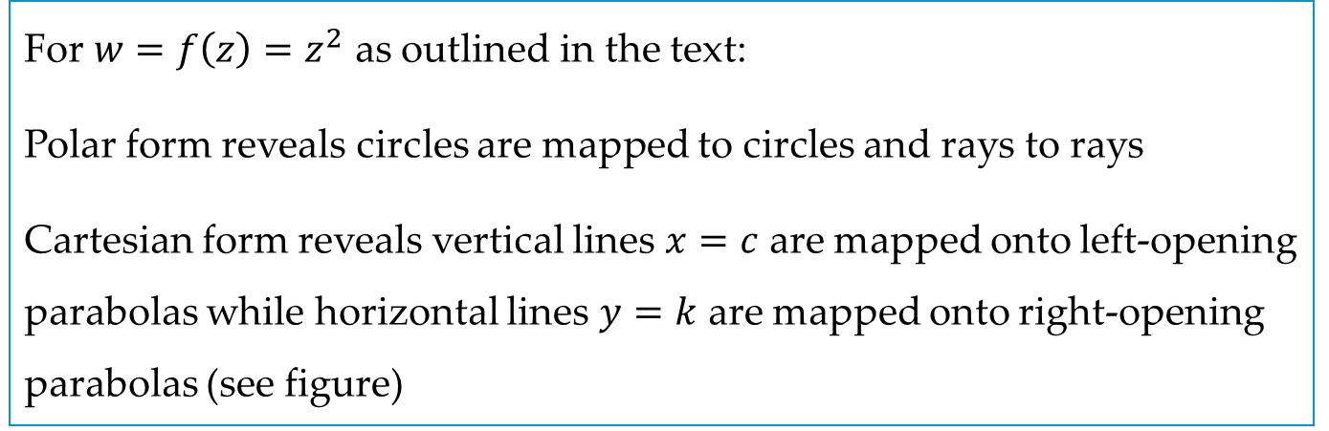
EXAMPLE 1
For $w=f\left(z\right)=z^{2}$ as outlined in the text:
Polar form reveals circles are mapped to circles and rays to rays
Cartesian form reveals vertical lines $x=c$ are mapped onto left-opening parabolas while horizontal lines $y=k$ are mapped onto right-opening parabolas (see figure)

Slide 5
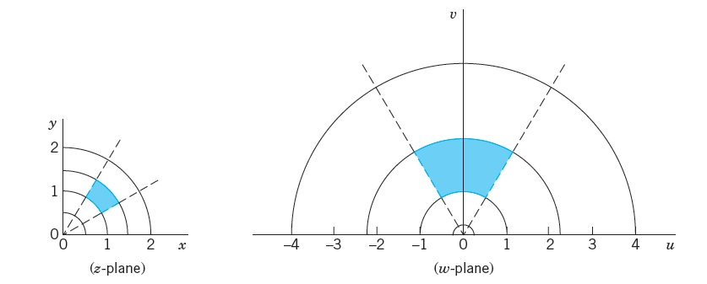
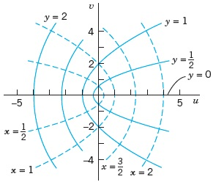
EXAMPLE 1

Slide 6
17.2 Linear Fractional Transformations

Slide 7
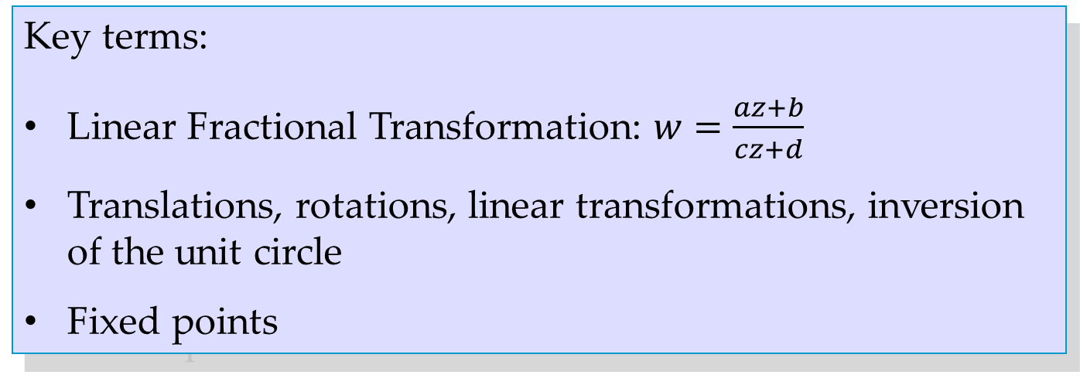
Key terms:
Linear Fractional Transformation: $w=\frac{az+b}{cz+d}$
Translations, rotations, linear transformations, inversion of the unit circle
Fixed points

Slide 8
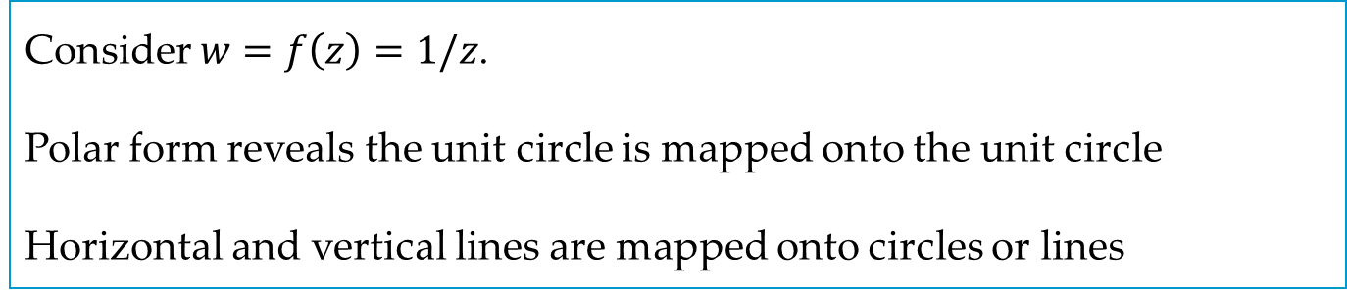
EXAMPLE 1
Consider $w=f\left(z\right)=1/z$.
Polar form reveals the unit circle is mapped onto the unit circle
Horizontal and vertical lines are mapped onto circles or lines

Slide 9
17.3 Special Linear Fractional Transformations

Slide 10
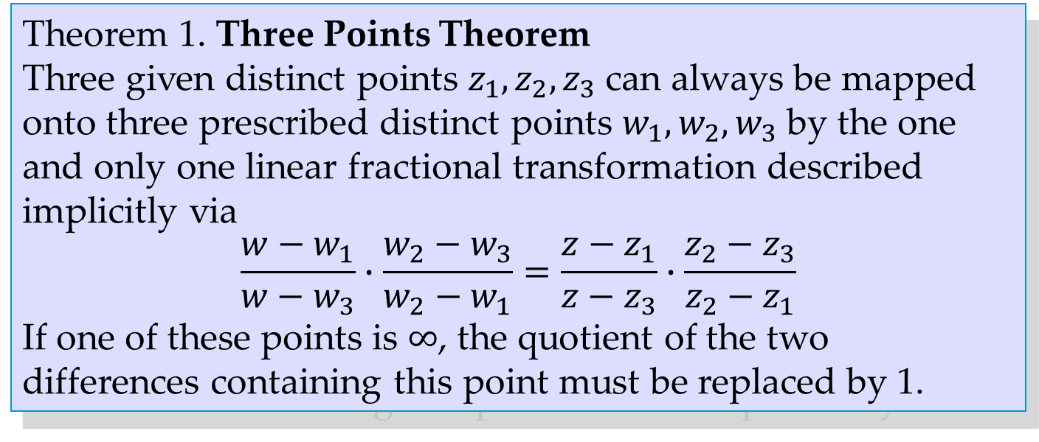
Theorem 1. Three Points Theorem
Three given distinct points $z_{1}, z_{2}, z_{3}$ can always be mapped onto three prescribed distinct points $w_{1}, w_{2}, w_{3}$ by the one and only one linear fractional transformation described implicitly via
$$\frac{w−w_{1}}{w−w_{3}}∙\frac{w_{2}−w_{3}}{w_{2}−w_{1}}=\frac{z−z_{1}}{z−z_{3}}∙\frac{z_{2}−z_{3}}{z_{2}−z_{1}}$$
If one of these points is $∞$, the quotient of the two differences containing this point must be replaced by 1.

Slide 11
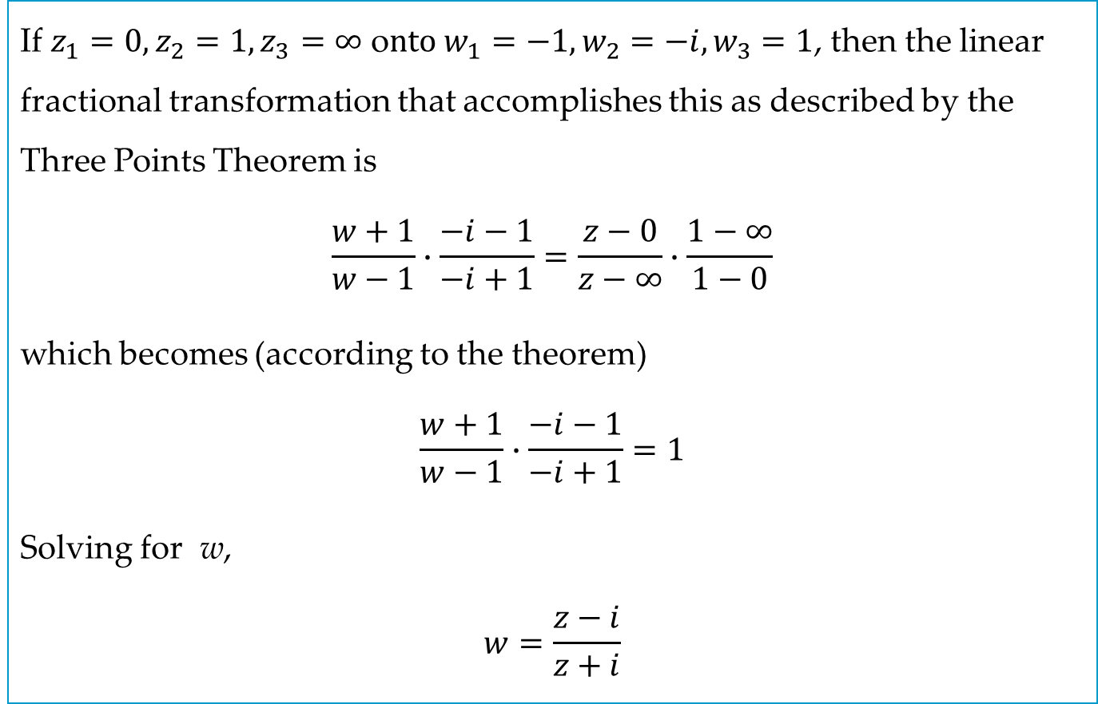
EXAMPLE 2
If $z_{1}=0, z_{2}=1, z_{3}=∞$ o$nto w_{1}=−1, w_{2}=−i, w_{3}=1$, then the linear fractional transformation that accomplishes this as described by the Three Points Theorem is
$$\frac{w+1}{w−1}∙\frac{−i−1}{−i+1}=\frac{z−0}{z−∞}∙\frac{1−∞}{1−0}$$
which becomes (according to the theorem)
$$\frac{w+1}{w−1}∙\frac{−i−1}{−i+1}=1$$
Solving for w,
$$w=\frac{z−i}{z+i}$$

Slide 12
17.4 Conformal Mapping by Other Functions

Slide 13
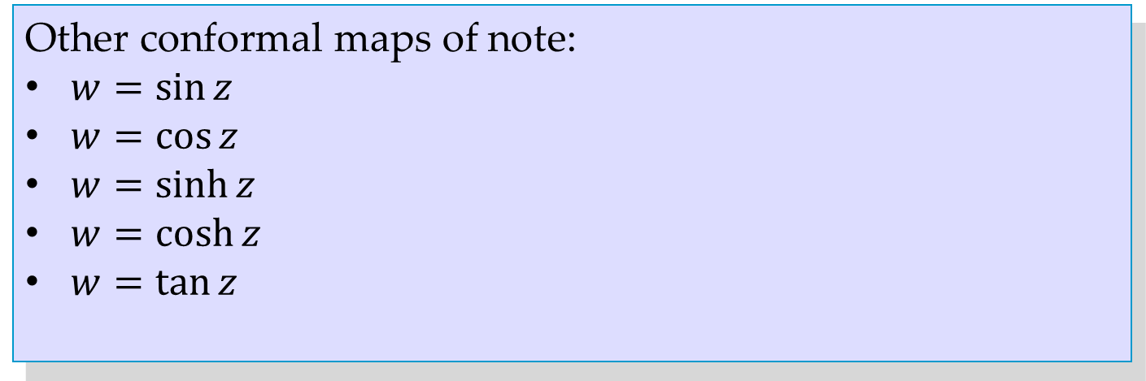
Other conformal maps of note:
$w=\sin{z}$
$w=\cos{z}$
$w=\sinh{z}$
$w=\cosh{z}$
$w=\tan{z}$

Slide 14
17.5 Riemann Surfaces

Slide 15
Key concept/terms:
A Riemann surface allows multivalued functions to be viewed as single-valued functions consisting of several “sheets”.
Branch point

